Slide 1
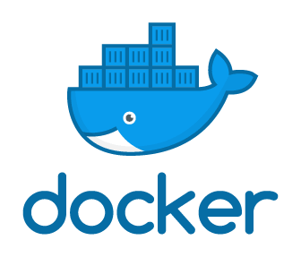
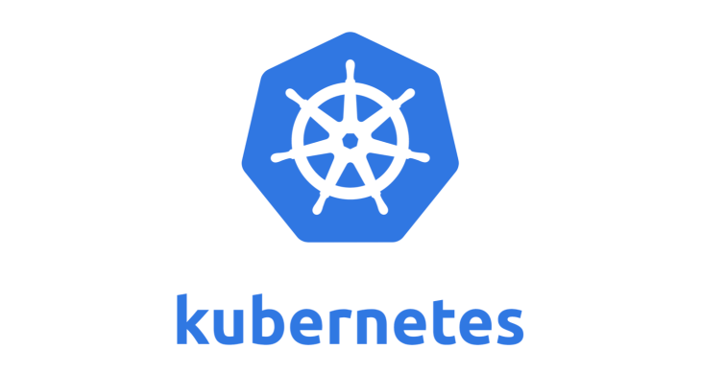
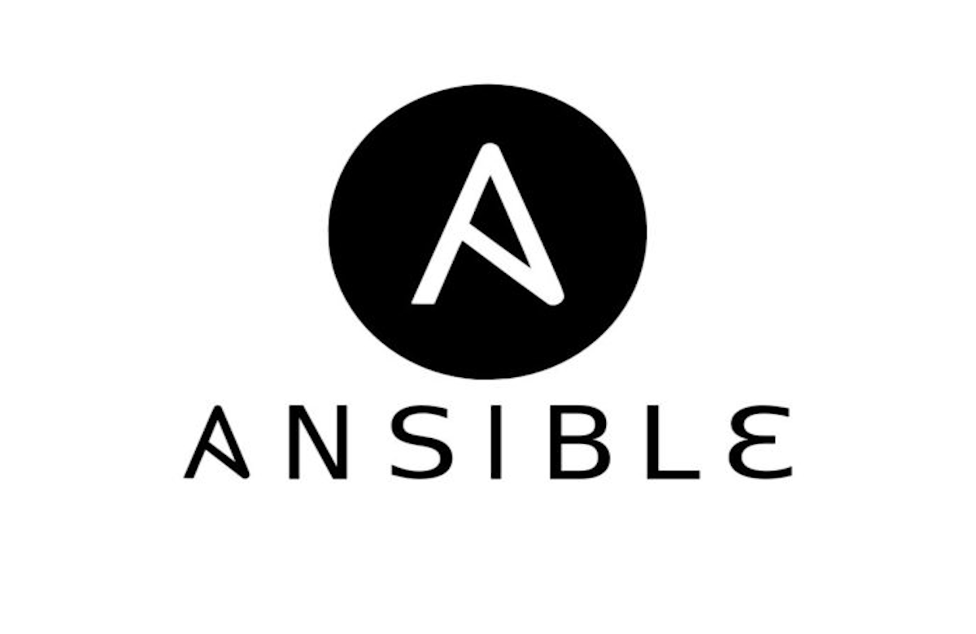
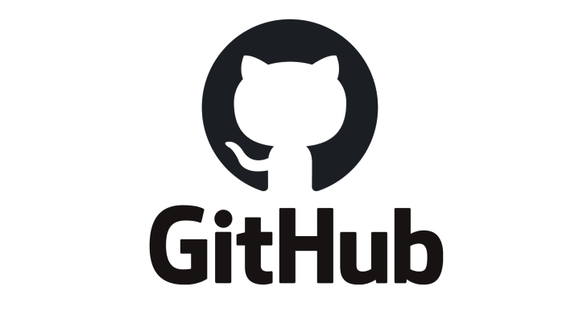
Day 3 Eurocontrol June, 15th 2021

Slide 3
What is GitHub
GitHub is a code hosting platform for version control and collaboration. It lets you and others work together on projects from anywhere.

Slide 4
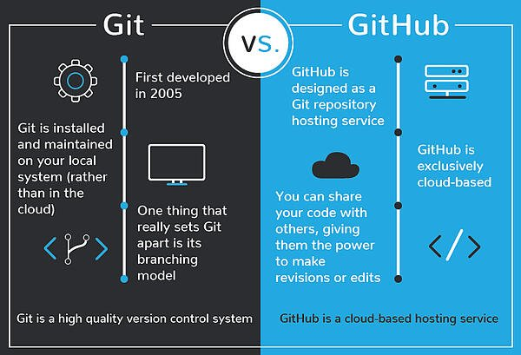

Slide 5
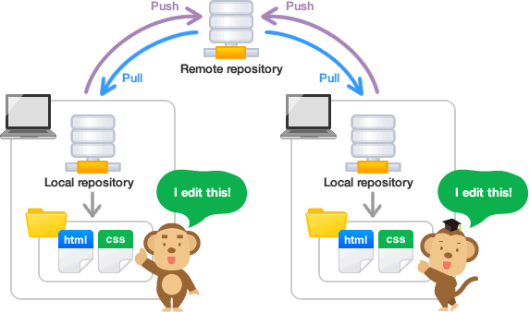

Slide 6
Step 0: Install git and create GitHub account
Installing on Windows
There are also a few ways to install Git on Windows. The most official build is available for download on the Git website. Just go to https://git-scm.com/download/win and the download will start automatically. Note that this is a project called Git for Windows, which is separate from Git itself; for more information on it, go to https://gitforwindows.org.

Slide 7
Step 1: Create a local git repository
Command: git init

Slide 8
github
Create a new repository
Add the files to the repository
Create a new file in github
Git pull
Git clone to get an existing repo

Slide 9
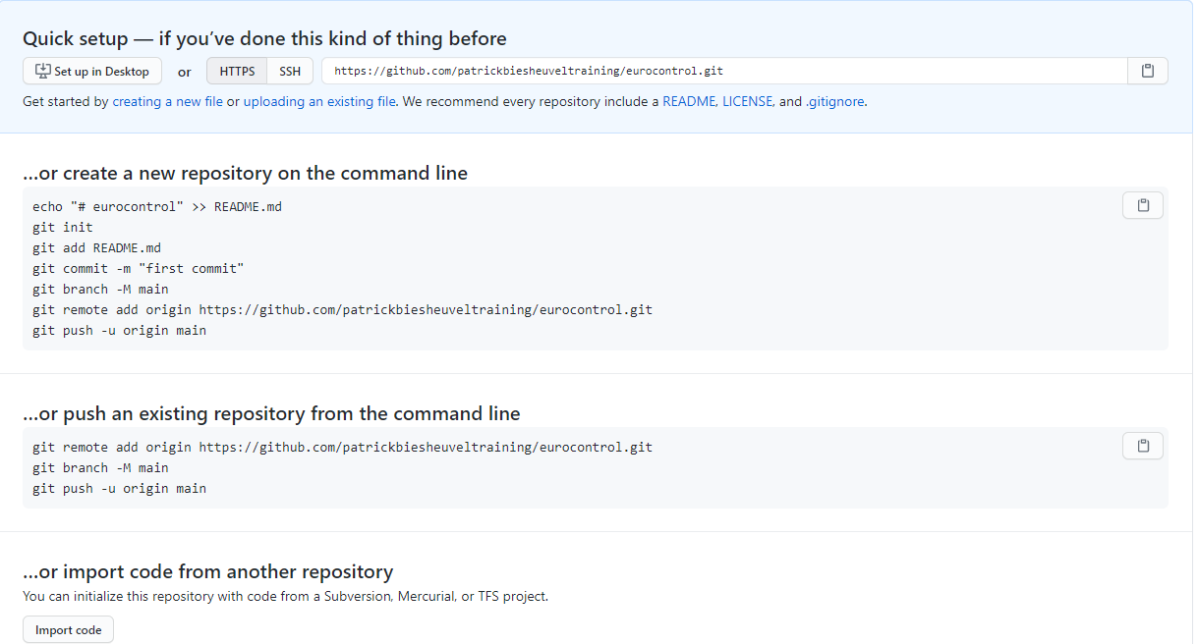

Slide 11
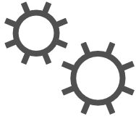


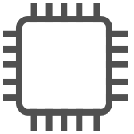


Virtualization and containers
Operating system
Operating system
Device running virtual machines
Device running containers
Virtual machine
Container
Apps
Services
Kernel
Apps
Services
Kernel
Hardware
Hardware
Notes:
Containers and VMs each have their uses. In fact, many container deployments use VMs as the host operating system rather than running directly on the hardware, especially when running containers in the cloud.
A container is an isolated, lightweight silo for running an application on a host operating system. Containers build on top of a host operating system's kernel, and they contain only apps and some lightweight operating system APIs and services that run in user mode.
In contrast to containers, VMs run complete operating systems, including their own kernels.

Slide 12




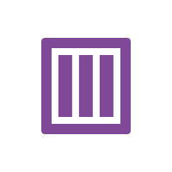

Containers
Mechanism to package and deploy an application
Linux
Operating system
Windows
Application code
Development
Dependencies
Datacenter
Files
Cloud
Notes:
A container is a loosely isolated environment that allows us to build and run software packages. These software packages include the code and all dependencies to run applications quicker and more reliably in most computing environments. These packages are known as container images.
A container image becomes the unit for distributing applications. Software containerization is an operating system virtualization method that you can use to deploy and run containers without using a VM. Containers can run on physical hardware, in the cloud, on VMs, and across multiple operating systems.

Slide 13

Docker
Containerization platform
Runs "on top of" an operating system
Doesn't require a hypervisor
Runs anywhere
Your desktop/laptop
Server environment
DevOps tools
Cloud services
Containerized applications
Infrastructure
Operating system
Docker
Application 1
Application 2
Application 3
Application 4
Application 5
Notes:
Docker is a containerization platform that you can use to develop, ship, and run containers. Docker doesn't use a hypervisor, and you can run it on a desktop or laptop if you're developing and testing applications. The desktop version of Docker supports Linux, Windows, and macOS. For production systems, Docker is available for server environments, including many variants of Linux and Windows Server 2016 and newer versions.
The Docker platform consists of several components that you can use to build, run, and manage containerized applications.

Slide 14
Docker terminology
Container
A standardized "unit of software" that contains everything required for an application to run
Container Image
A template that can be used to create one or more containers
Build
The process of creating a container image using a set of instructions
Pull
The process of downloading a container image from a container registry
Push
The process of uploading a container image to a container registry
Dockerfile
A text file that contains instructions required to build a Docker image.
Notes:
You should be familiar with the following key terms before using Docker and Azure Container Instances to create, build, and test containers:
Container: This is an instance of a Docker image. It represents the execution of a single application, process, or service. It consists of the contents of a Docker image, an execution environment, and a standard set of instructions. When scaling a service, you create multiple instances of a container from the same image. Or a batch job can create multiple containers from the same image, passing different parameters to each instance.
Container image: This refers to a package with all the dependencies and information required to create a container. The dependencies include frameworks and the deployment and execution configuration that a container runtime uses. Usually, an image derives from multiple base images that are layers stacked on top of each other to form the container's file system. An image is immutable once it has been created.
Build: This refers to the action of building a container image based on the information and context provided by its Dockerfile, plus additional files in the folder where the image is built. You can build images by using the Docker docker build command.
Pull: This refers to the process of downloading a container image from a container registry.
Push: This refers to the process of uploading a container image to a container registry.
Dockerfile: This refers to a text file that contains instructions on how to build a Docker image. It's like a batch script; the first line states the base image, followed by instructions to install required programs, copy files, and so on until you get the working environment you need.

Slide 15
Retrieving a new container image from Docker Hub
# Get Ubuntu container image
docker pull ubuntu
# Get version 5.7 of MySQL container image
docker pull mysql:5.7
# Get the latest version of the nginx container image
docker pull nginx:latest
Container image name
Container image tag
Notes:
Use the docker build command to create the container image and tag it as aci-tutorial-app.
Output from the docker build command is similar to the following (truncated for readability):
$ docker build ./aci-helloworld -t aci-tutorial-app
Sending build context to Docker daemon 119.3kB
Step: FROM node:8.9.3-alpine
8.9.3-alpine: Pulling from library/node
88286f41530e: Pull complete
84f3a4bf8410: Pull complete
d0d9b2214720: Pull complete
Digest: sha256:c73277ccc763752b42bb2400d1aaecb4e3d32e3a9dbedd0e49885c71bea07354
Status: Downloaded newer image for node:8.9.3-alpine
---> 90f5ee24bee2
...
Step: CMD node /usr/src/app/index.js
---> Running in f4a1ea099eec
---> 6edad76d09e9
Removing intermediate container f4a1ea099eec
Successfully built 6edad76d09e9
Successfully tagged aci-tutorial-app:latest
Use the docker images command to examine the built image. Your newly built image should appear in the list:
$ docker images
REPOSITORY TAG IMAGE ID CREATED SIZE
aci-tutorial-app latest 5c745774dfa9 39 seconds ago 68.1 MB

Slide 16
Running the retrieved container image
# Get the .NET application sample container image
docker pull mcr.microsoft.com/dotnet/core/samples:dotnetapp
# Run your container locally
docker run mcr.microsoft.com/dotnet/core/samples:dotnetapp
# View running containers
docker container ls -a
Image name and tag
Notes:
Before deploying a container to Container Instances, use the docker run command to run it locally and confirm that it works. The -d switch lets the container run in the background, while -p allows you to map an arbitrary port on your computer to port 80 in the container.
Output from the docker run command displays the running container's ID if the command is successful:
$ docker run -d -p 8080:80 aci-tutorial-app
A2e3e4435db58ab0c664ce521854c2e1a1bda88c9cf2fcff46aedf48df86cccf

Slide 17
Demonstration: Retrieving and deploying an existing Docker image locally
Notes:
docker pull mcr.microsoft.com/dotnet/core/samples:aspnetapp
docker image list
docker run -d -p 8080:80 mcr.microsoft.com/dotnet/core/samples:aspnetapp
Open a web browser and go to the page for the sample web app at http://localhost:8080
docker ps
docker container stop
docker ps –a
docker container rm
docker ps -a
docker image list
docker image rm mcr.microsoft.com/dotnet/core/samples:aspnetapp
docker image list

Slide 18
Creating a container image specification with a Dockerfile
FROM node:8.9.3-alpine
RUN mkdir -p /usr/src/app
COPY ./app/ /usr/src/app/
WORKDIR /usr/src/app
RUN npm install
CMD node /usr/src/app/index.js
Start with this container image
Run this command
Copy these files from the host
Change the working directory
Start the container with this command
Notes:
The sample application in this tutorial is a simple web app built in Node.js. The application serves a static HTML page, and you can use Git to clone the sample application's repository:
git clone https://github.com/Azure-Samples/aci-helloworld.git
The Dockerfile for an application indicates how the container is built.
The Dockerfile starts from an official Node.js image that’s based on Alpine Linux, a small distribution that’s well suited for use with containers. It then copies the application files into the container, installs dependencies by using the Node Package Manager, and finally, starts the application.

Slide 19
Building the container image
# Build your container
docker build ./application -t tutorial-app
# After building, use the following command to view your new container image
docker images
Path to build
Docker tag
Notes:
Use the docker build command to create the container image and tag it as aci-tutorial-app.
Output from the docker build command is similar to the following (truncated for readability):
$ docker build ./aci-helloworld -t aci-tutorial-app
Sending build context to Docker daemon 119.3kB
Step: FROM node:8.9.3-alpine
8.9.3-alpine: Pulling from library/node
88286f41530e: Pull complete
84f3a4bf8410: Pull complete
d0d9b2214720: Pull complete
Digest: sha256:c73277ccc763752b42bb2400d1aaecb4e3d32e3a9dbedd0e49885c71bea07354
Status: Downloaded newer image for node:8.9.3-alpine
---> 90f5ee24bee2
...
Step: CMD node /usr/src/app/index.js
---> Running in f4a1ea099eec
---> 6edad76d09e9
Removing intermediate container f4a1ea099eec
Successfully built 6edad76d09e9
Successfully tagged aci-tutorial-app:latest
Use the docker images command to examine the built image. Your newly built image should appear in the list:
$ docker images
REPOSITORY TAG IMAGE ID CREATED SIZE
aci-tutorial-app latest 5c745774dfa9 39 seconds ago 68.1 MB

Slide 20
Running the custom container image as a container
# Run your container locally
docker run -d -p 8080:80 tutorial-app
# View running containers
docker container ls -a
Notes:
Before you deploy a container to Container Instances, use the docker run command to run it locally and confirm that it works. The -d switch lets the container run in the background, while -p allows you to map an arbitrary port on your computer to port 80 in the container.
Output from the docker run command displays the running container's ID if the command is successful:
$ docker run -d -p 8080:80 aci-tutorial-app
A2e3e4435db58ab0c664ce521854c2e1a1bda88c9cf2fcff46aedf48df86cccf

Slide 21
Demonstration: Creating a container image by using Docker
Notes:
git clone https://github.com/MicrosoftDocs/mslearn-hotel-reservation-system.git
cd mslearn-hotel-reservation-system/src
echo "" > Dockerfile
notepad Dockerfile
FROM mcr.microsoft.com/dotnet/core/sdk:2.2
WORKDIR /src
COPY ["HotelReservationSystem/HotelReservationSystem.csproj", "HotelReservationSystem/"]
COPY ["HotelReservationSystemTypes/HotelReservationSystemTypes.csproj", "HotelReservationSystemTypes/"]
RUN dotnet restore "HotelReservationSystem/HotelReservationSystem.csproj“
COPY . .
WORKDIR "/src/HotelReservationSystem"
RUN dotnet build "HotelReservationSystem.csproj" -c Release -o /app
RUN dotnet publish "HotelReservationSystem.csproj" -c Release -o /app
EXPOSE 80
WORKDIR /app
ENTRYPOINT ["dotnet", "HotelReservationSystem.dll“
BUILD AND DEPLOY
docker build -t reservationsystem .
docker image list
docker run -p 8080:80 -d --name reservations reservationsystem
http://localhost:8080/api/reservations/1
docker ps –a
docker container stop reservations
docker rm reservations
docker image rm <image name>

Slide 22
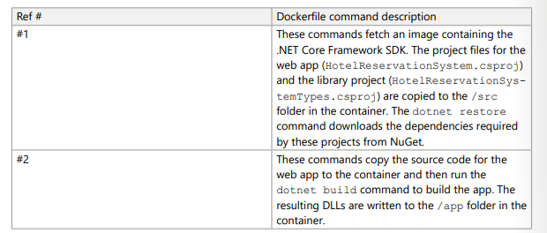
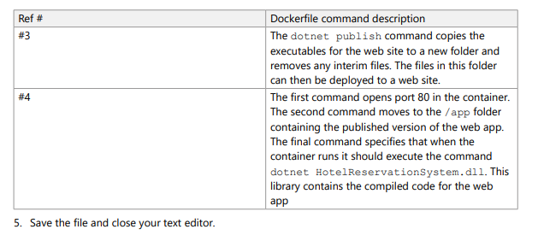

Slide 23
Ansible docker
Git clone https://github.com/ned1313/docker-centos7-ansible
docker build -t centos7-ansible-oneview .
docker run -it centos7-ansible-oneview /bin/bash

Slide 24
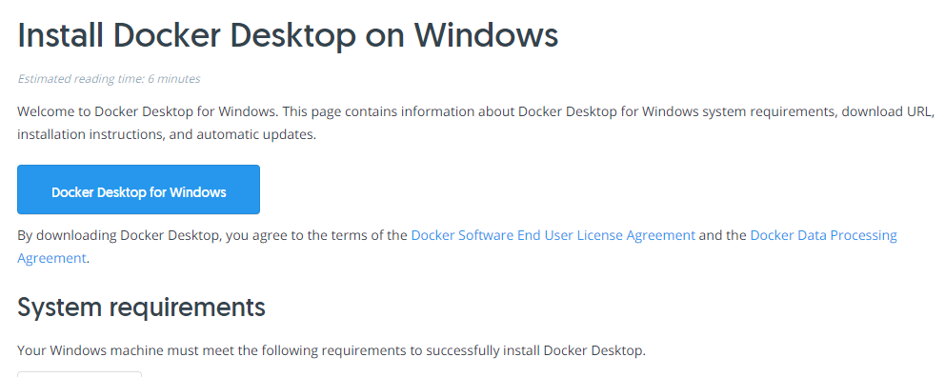
Docker Desktop for Windows
https://docs.docker.com/docker-for-windows/install/

Slide 25
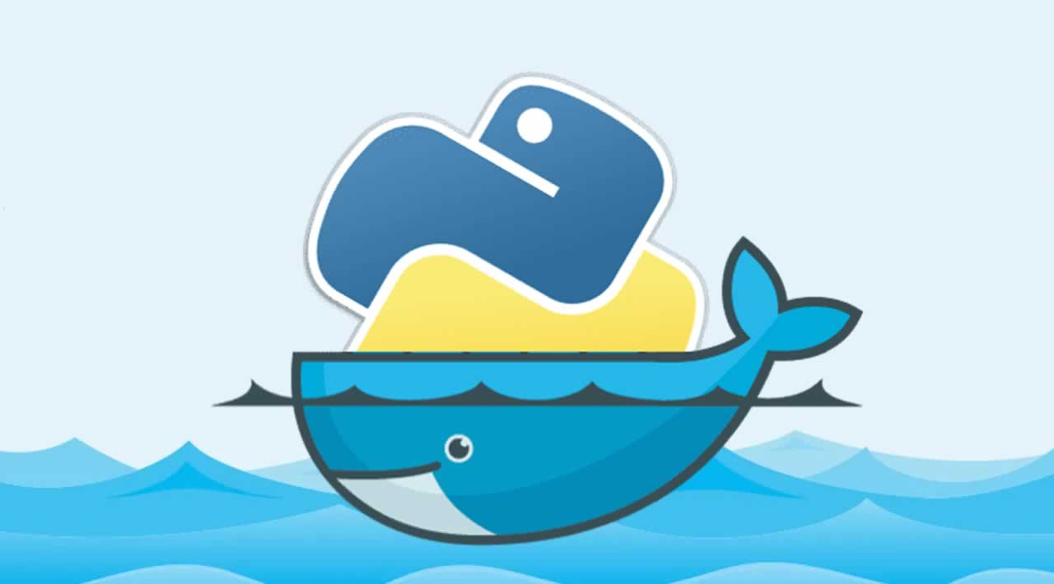
Dockerfile (capital D, small f, no extention)
#publicly available docker image "python" on docker hub will be pulled
FROM python
#creating directory helloworld in container (linux machine)
RUN mkdir c:\home\helloworld
#copying helloworld.py from local directory to container's helloworld folder
COPY helloworld.py /home/helloworld/helloworld.py
#running helloworld.py in container
CMD python /home/helloworld/helloworld.py
Alternative: FROM python:alpine3.7

Slide 26
On your own machine
docker build -t helloworldapp .
docker run helloworldapp
docker run -i helloworldapp

Slide 27
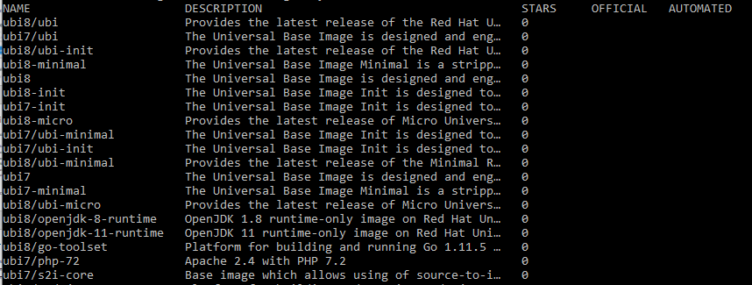
Ubi images from Red Hat
docker search registry.access.redhat.com/ubi

Slide 28
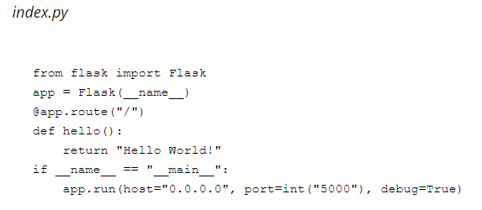
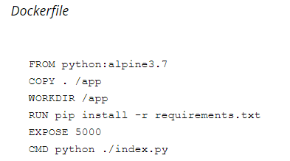
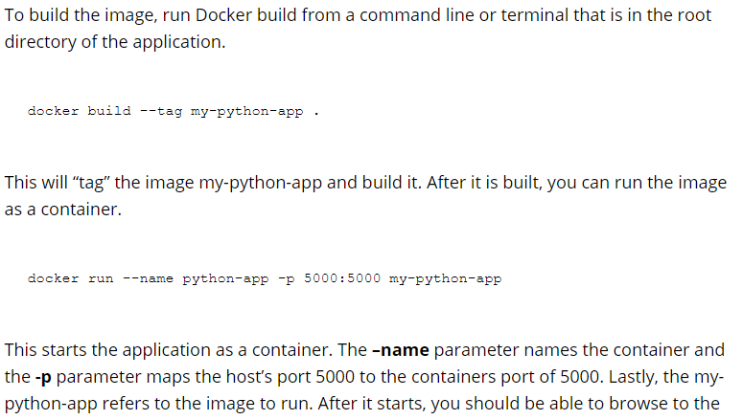
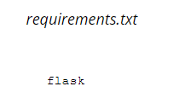
Notes:
https://www.wintellect.com/containerize-python-app-5-minutes/

Slide 30
Kubernetes
Manages container-based applications
Along with networking and storage requirements
Focused on application workloads instead of infrastructure components
Makes it easier to orchestrate large solutions using a variety of containers
Application containers
Storage containers
Middleware containers
Even more…
Applications are described declaratively
Use YAML files to describe application
Kubernetes handles management and deployment
Notes:
Kubernetes is a rapidly evolving platform that manages container-based applications and their associated networking and storage components. The focus is on the application workloads, not the underlying infrastructure components. Kubernetes provides a declarative approach to deployments, backed by a robust set of APIs for management operations.
You can build and run modern, portable, microservices-based applications that benefit from Kubernetes orchestrating and managing the availability of those application components. Kubernetes supports both stateless and stateful applications as teams progress through the adoption of microservices-based applications.
As an open platform, Kubernetes allows you to build your applications with your preferred programming language, OS, libraries, or messaging bus. Existing continuous integration and continuous delivery (CI/CD) tools can integrate with Kubernetes to schedule and deploy releases.

Slide 31
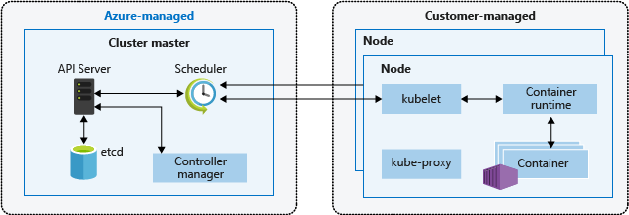
Kubernetes cluster architecture
Cluster master
Dedicated nodes provide core Kubernetes services and orchestration
Nodes
Run application workloads
Notes:
A Kubernetes cluster is divided into two components:
Cluster master nodes provide the core Kubernetes services and orchestration of application workloads.
Nodes run your application workloads.
Cluster master
When you create an AKS cluster, a cluster master is automatically created and configured. This cluster master is provided as a managed Azure resource abstracted from the user. There is no cost for the cluster master, only the nodes that are part of the AKS cluster.
Nodes and node pools
To run your applications and supporting services, you need a Kubernetes node. An AKS cluster has one or more nodes, which is an Azure virtual machine (VM) that runs the Kubernetes node components and container runtime.

Slide 32
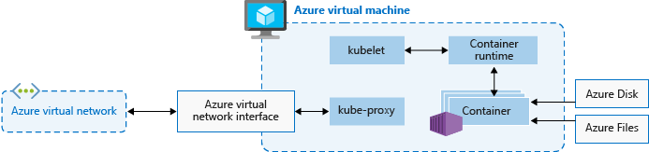
Kubernetes nodes
Each individual node is an Azure virtual machine (VM )
Contains Kubernetes node components needed to communicate with the cluster master and the internet
Contains the container runtime for your applications
In Azure Kubernetes Service, Docker is the container runtime
Notes:
The kubelet is the Kubernetes agent that processes the orchestration requests from the cluster master and scheduling of running the requested containers.
Virtual networking is handled by the kube-proxy on each node. The proxy routes network traffic and manages IP addressing for services and pods.
The container runtime is the component that allows containerized applications to run and interact with additional resources such as the virtual network and storage. In AKS, Docker is used as the container runtime.

Slide 33
Kubernetes terminology
Nodes
Individual VM running containerized applications
Pools
Groups of nodes with identical configurations
Pods
Single instance of an application
It’s possible for a pod to contain multiple containers within the same node
Deployments
One or more identical pods managed by Kubernetes
Manifests
YAML file describing a deployment
Notes:
Nodes
An AKS cluster has one or more nodes, which is an Azure virtual machine (VM) that runs the Kubernetes node components and container runtime.
In AKS, the VM image for the nodes in your cluster is currently based on Ubuntu Linux. When you create an AKS cluster or scale up the number of nodes, the Azure platform creates the requested number of VMs and configures them. There is no manual configuration for you to perform.
Node pools
Nodes of the same configuration are grouped together into node pools. A Kubernetes cluster contains one or more node pools. The initial number of nodes and size are defined when you create an AKS cluster, which creates a default node pool. This default node pool in AKS contains the underlying VMs that run your agent nodes.
Pods
Kubernetes uses pods to run an instance of your application. A pod represents a single instance of your application. Pods typically have a 1:1 mapping with a container, although there are advanced scenarios where a pod may contain multiple containers. These multi-container pods are scheduled together on the same node, and allow containers to share related resources.
A pod is a logical resource, but the container(s) are where the application workloads run. Pods are typically ephemeral, disposable resources, and individually scheduled pods miss some of the high availability and redundancy features that Kubernetes provides. Instead, pods are usually deployed and managed by Kubernetes Controllers, such as the Deployment Controller.
Manifests
A YAML file describing a deployment.
Deployments
A deployment represents one or more identical pods, managed by the Kubernetes Deployment Controller. A deployment defines the number of replicas (pods) to create, and the Kubernetes Scheduler ensures that if pods or nodes encounter problems, additional pods are scheduled on healthy nodes.
You can update deployments to change the configuration of pods, container image used, or attached storage. The Deployment Controller drains and terminates a given number of replicas, creates replicas from the new deployment definition, and continues the process until all replicas in the deployment are updated.

Slide 34
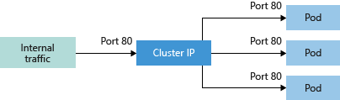
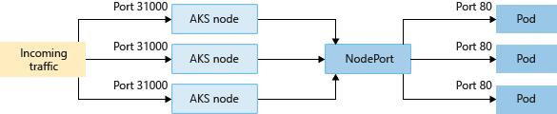
Networking connectivity
Services group pods together to provide network connectivity
Cluster IP
Creates internal-only IP address for use within the cluster
NodePort
Creates a port mapping on a specific node for direct access
Notes:
To simplify the network configuration for application workloads, Kubernetes uses Services to logically group a set of pods together and provide network connectivity. The following service types are available:
Cluster IP
Creates an internal IP address for use within the AKS cluster. Good for internal-only applications that support other workloads within the cluster.
NodePort
Creates a port mapping on the underlying node that allows the application to be accessed directly with the node IP address and port.

Slide 35
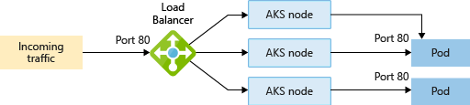
Networking connectivity (continued)
Services group pods together to provide network connectivity
LoadBalancer
Creates an Azure load balancer resource with an external IP address
ExternalName
Creates a direct DNS entry
Notes:
To simplify the network configuration for application workloads, Kubernetes uses Services to logically group a set of pods together and provide network connectivity. The following Service types are available:
LoadBalancer
Creates an Azure load balancer resource, configures an external IP address, and connects the requested pods to the load balancer back-end pool. To allow customers traffic to reach the application, load balancing rules are created on the desired ports.
ExternalName
Creates a specific DNS entry for easier application access.

Slide 36
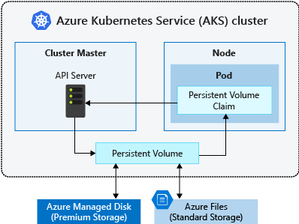
Storage
Local storage on the node is fast and simple to use
Local storage might not be available after the pod is deleted
Multiple pods may share data volumes
Storage could potentially be reattached to another pod
Notes:
Applications that run in Azure Kubernetes Service (AKS) may need to store and retrieve data. For some application workloads, this data storage can use local, fast storage on the node that is no longer needed when the pods are deleted. Other application workloads might require storage that persists on more regular data volumes within the Azure platform. Multiple pods might need to share the same data volumes, or reattach data volumes if the pod is rescheduled on a different node. Finally, you might need to inject sensitive data or application configuration information into pods.

Slide 37
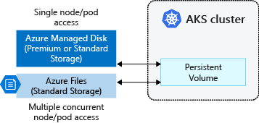
Persistent storage volumes
Pods can use storage that is persistent
Storage exists beyond the lifetime of the pod
Storage can be a service such as Azure Files or an Azure Managed Disk
Notes:
Volumes are defined and created as part of the pod lifecycle and only exist until the pod is deleted. Pods often expect their storage to remain if a pod is rescheduled on a different host during a maintenance event, especially in StatefulSets. A persistent volume (PV) is a storage resource created and managed by the Kubernetes API that can exist beyond the lifetime of an individual pod.
Azure Disks or Files are used to provide the PersistentVolume. As noted in the previous section on Volumes, the choice of Disks or Files is often determined by the need for concurrent access to the data or the performance tier.

Slide 38
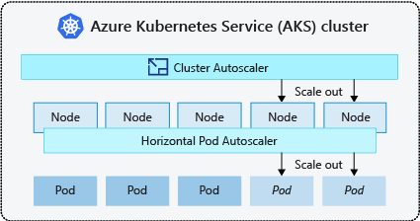
Scaling
Applications might grow beyond the capacity of a single pod
Kubernetes has built-in autoscalers to automatically create instances when they are needed
Horizontal pod autoscaler
Automatically scale replicas based on metrics
Cluster Autoscaler
Adjusts the number of nodes based on the requested compute resources
Notes:
As you run applications in AKS, you might need to increase or decrease the amount of compute resources. As the number of application instances you need change, the number of underlying Kubernetes nodes might also need to change. You also might need to quickly provision a large number of additional application instances.
Horizontal pod autoscaler
Kubernetes uses the horizontal pod autoscaler (HPA) to monitor the resource demand and automatically scale the number of replicas. By default, the horizontal pod autoscaler checks the Metrics API every 30 seconds for any required changes in replica count. When changes are required, the number of replicas is increased or decreased accordingly.
Cluster autoscaler
To respond to changing pod demands, Kubernetes has a cluster autoscaler that adjusts the number of nodes based on the requested compute resources in the node pool. By default, the cluster autoscaler checks the API server every 10 seconds for any required changes in node count. If the cluster autoscale determines that a change is required, the number of nodes in your AKS cluster is increased or decreased accordingly.

Slide 39
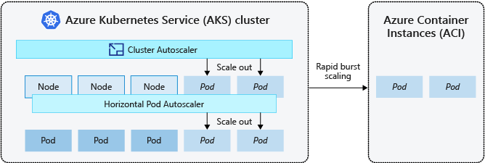
Scaling to Azure Container Instances
If you need to rapidly grow your AKS cluster, you can create new pods in Azure Container Instances (ACI)
Notes:
Burst to Azure Container Instances
To rapidly scale your AKS cluster, you can integrate with Azure Container Instances (ACI). Kubernetes has built-in components to scale the replica and node count. However, if your application needs to scale rapidly, the horizontal pod autoscaler may schedule more pods than can be provided by the existing compute resources in the node pool. If configured, this scenario would then trigger the cluster autoscaler to deploy additional nodes in the node pool, but it might take a few minutes for those nodes to successfully provision and allow the Kubernetes scheduler to run pods on them.

Slide 40
Notes:
Page 107 CLI
Page 113 Portal
Github.com/Azure-Samples/azure-voting-app-redis

Slide 42
Installing Ansible on Windows
https://geekflare.com/ansible-installation-windows/

Slide 43
What is Ansible
Ansible is an open source automation and orchestration tool for software provisioning, configuration management, and software deployment. Ansible can easily run and configure Unix-like systems as well as Windows systems to provide infrastructure as code. It contains its own declarative programming language for system configuration and management.

Slide 44
Why use Ansible
One of the most significant advantages of Ansible is that it is free to use by everyone.
It does not need any special system administrator skills to install and use Ansible, and the official documentation is very comprehensive.
Its modularity regarding plugins, modules, inventories, and playbooks make Ansible the perfect companion to orchestrate large environments.
Ansible is very lightweight and consistent, and no constraints regarding the operating system or underlying hardware are present.
It is also very secure due to its agentless capabilities and due to the use of OpenSSH security features.
Another advantage that encourages the adoption of Ansible is its smooth learning curve determined by the comprehensive documentation and easy to learn structure and configuration.

Slide 45
Terminology
Ansible server: The machine where Ansible is installed and from which all tasks and playbooks will be ran
Module: Basically, a module is a command or set of similar Ansible commands meant to be executed on the client-side
Task: A task is a section that consists of a single procedure to be completed
Role: A way of organizing tasks and related files to be later called in a playbook
Fact: Information fetched from the client system from the global variables with the gather-facts operation
Inventory: File containing data about the ansible client servers. Defined in later examples as hosts file
Play: Execution of a playbook
Handler: Task which is called only if a notifier is present
Notifier: Section attributed to a task which calls a handler if the output is changed
Tag: Name set to a task which can be used later on to issue just that specific task or group of tasks.

